Slide 1
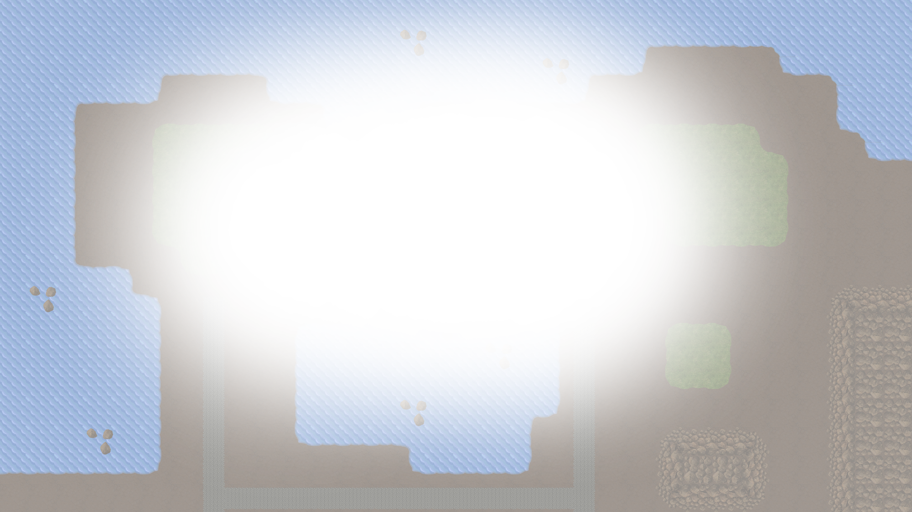






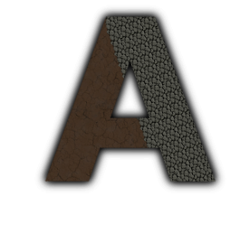


Majaro – Matt, James, Rob
Notes:
TOTAL TIME [ 40 – 40 – 30 – 30 – 30 – 60 – 90 – 20 – 30 – 40 - 30 > 440s / 7.20min ]

Slide 2
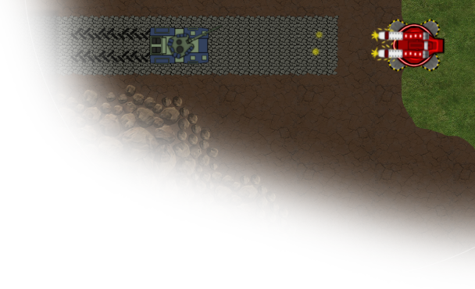
Game Origins
Considered genres;
Reaction (Mario Party)
Simulation (Sims)
Board Games (Risk)
RTS (Age of Empires)
Agreed on an RTS Genre taking inspiration from Command & Conquer Tiberium Twilight
Resultantly we felt by being browser-based for accessibility and by implementing a full top-down implementation our game was unique.
Notes:
ORIGINS [ 40s ]
Proposed variety of different genres we enjoyed
Voted on our top three favourite
Took inspiration from Tiberium Twilight
Top down possible under time constraints & browser based new twist and spec

Slide 3
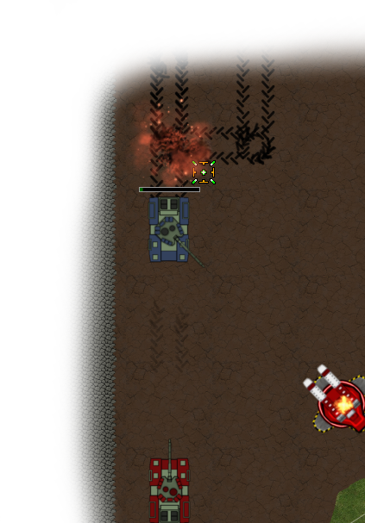
Project Strategy
Created feature plan for the game
Tailored the plan for scalability
Fundamentals implemented first
Once stable extra features were added
Testing occurred semi-regularly
Features tested on implementation
Sam and Steve tested ‘stable’ builds on Fridays
Alpha testing was done by friendly office testers
Notes:
PROCESS [ 40s ]
Game plan – functional requirements (features)
Created development stories
Prioritise stories to create core game – turrets and tanks
Game was implemented a module at a time until we had a basic and reasonably stable engine which we could expand upon
Testing of the game occurred through user acceptance testing. The game was tested after the addition of each feature. We tried to create a stable build each Friday for testing by Sam and Steve

Slide 4
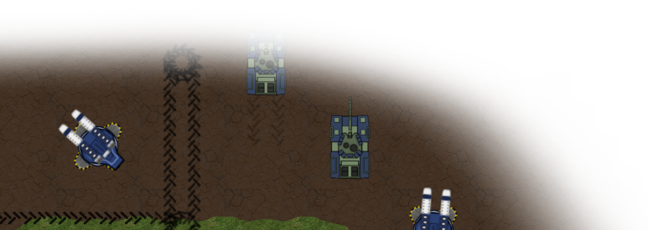
Project Strategy Rationale
Core functionality completed first to assure a stable functioning game
Weekly Friday meetings allowed us to stay on track and judge progress
Regular testing helped us locate and fix bugs as soon as they occurred
Notes:
WHY [ 30s ]
Core functionality completed first so we had a stable basis to work on
Used weekly Friday meetings to keep us on track and get external opinion on our progress
Automating game testing was very difficult and we found it more productive to use user acceptance testing to both locate bugs and balance gameplay

Slide 5
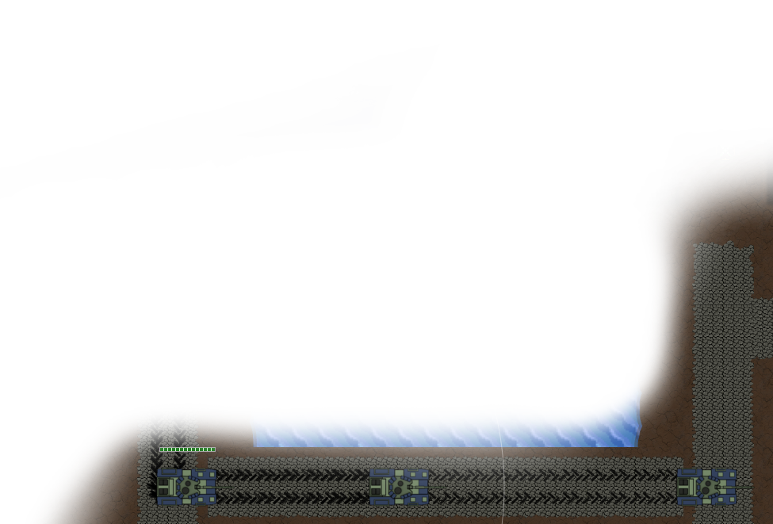
Key Technologies
Backend Server:
Java, Netty, REST Easy, MySQL
Frontend Client:
Angular, Phaser, SocketIO, HTML5, CSS3
Other:
GIMP 2.8, Git, JIRA, Eclipse
Notes:
TECHNOLOGIES [ 50s ]
State the main technologies used in the project and say where they were used/what they were used for
Mention extra detail for each of the above technologies, notably:
Netty : Socket IO implementation
Phaser : JavaScript game engine
GIMP 2.8 : Creating images/sprites/animations

Slide 6
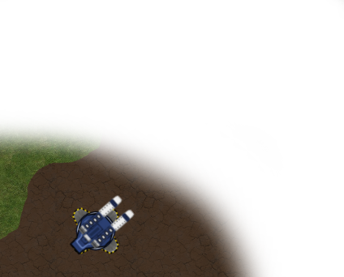
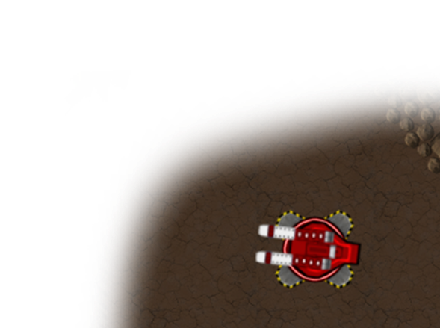

Technology Rationale
Chose relevant technologies usable beyond the project
Java Server, Angular Client, MySQL Database
Phaser.js used for client game engine
Technology chosen for a more comprehensive learning experience
Notes:
WHY [ 30s ]
Software transferrable skills to client projects
Phaser pixi powered – supports webGL and canvas
Languages chosen to gain broader experience

Slide 7
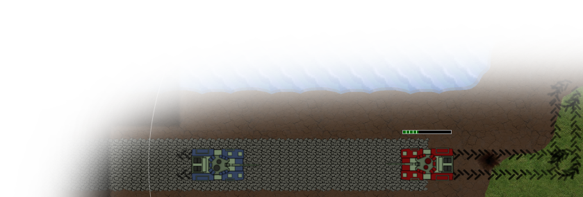
Project Progress Diary
Week 1 :
Brainstorming, Technology PoCs, Game engine research
Week 2 :
Game Engine PoC, UX web application design, Clientside turrets, Work on Login, Registration & Server List
Week 3 :
Further UI design, Socket & server engine constructed, Game Lobby
Notes:
DIARY 1 [ 60s ]
Week 1 :
Brainstorm ideas for the game / approach the development
PoC for various technologies (REST, Java-Tomcat, Angular, MySQL)
Server skeleton constructed
Week 2 :
PoC for Phaser game engine (Turrets)
UX design for web application
Work on Login, Registration & Server Lobby
Week 3 :
UI designed and implemented
Implemented server skeleton & socket framework
Work on Game Lobby

Slide 8
Project Progress Diary
Week 4 :
A* path finding, cross computer game sync, further game lobby & server list work
Week 5 :
Socket implementation changed, further maps created, Implemented; HUD, target selection, damage calculation and tank hub building
Week 6 :
Game balancing, added extra map, bug fixes (clearly not enough), Implemented; unit formations, map navigation, autofire, build radius
Notes:
DIARY 2 [ 90s ]
Week 4 :
Implemented path finding
Engine working cross computers / browsers
Concluding game lobby and server lobby
Week 5 :
Socket code to single unit (help reduce socket disconnections)
Created two and four player maps
Implemented HUD, target tracking, damage calculations, tank hub
Week 6 :
Game balancing
Implemented fog of war, movement formation, map navigation, autofire
Extra four player map added
Bug fixes

Slide 9
Scalability
Large consideration during engine design
Addition of new game items is quick and easy requiring few changes
Good practice for creating modular and extensible
Notes:
SCALABILITY [ 30s ]
Project scalability was a large consideration during many development decisions for the engine
Addition of new units/buildings/defences is very quick requiring a couple of additions to the constants file on server and client side
Gave us good practice in creating software which may be expanded upon at a later time

Slide 10
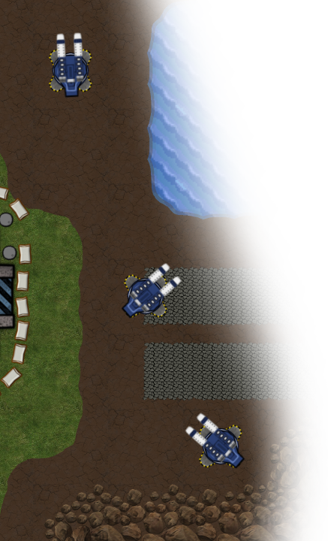
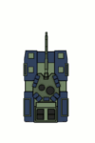
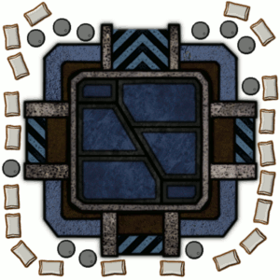

Creating Assets
Created using GIMP 2.8
Original sprite designs
Notes:
ASSETS [ 20s ]
Blag about how sprites were made a little
6 team colours with each sprite being available in each team colour

Slide 11
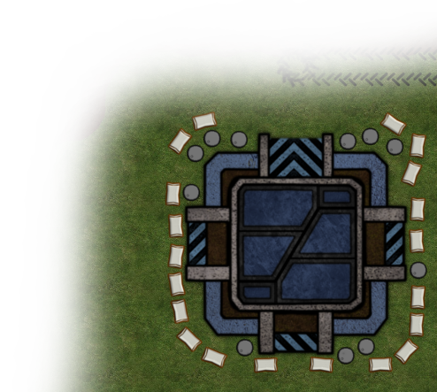
Challenges
Learning new technologies
Netty sockets and its quirks
Random disconnects cost lots of development time
Project management
Overly ambitious
No solid idea of exactly what features we would deliver (up in the air)
Software Issues
Git not utilised as well as it could have been
Eclipse. Just Eclipse.
Unit testing
Notes:
CHALLENGES [ 40s ]
Learning technologies we were not currently familiar with
Netty causing many issues with random disconnects resulting in losing days worth of development time
Overly ambitious original idea and needed a more solid idea of what we would be delivering
Git committing files incorrectly and not using branches from the start
Eclipse causing plenty of problems
Adding unit tests to the game proved to be difficult

Slide 12
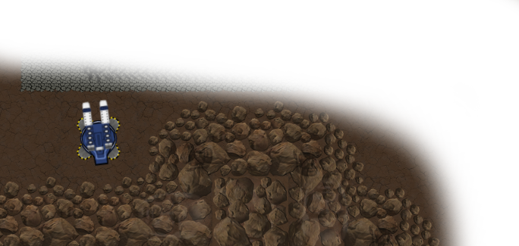

What would we do differently?
Use a different IDE (out of the hundreds available…)
More thorough weekly plans
Implement a single feature at a time
Unit Tests
Notes:
DIFFERENTLY [ 30s ]
Better weekly plans, including correct use of sprints, sticking to soft deadlines
Implement a single feature at a time; JIRA issues too broad
Unit tests but difficult for games

Slide 13
Any Questions?

